Slide 1
AI IN FINANCIAL SERVICES
DEFECT DETECTION FOR LAPTOPS
Industry Mentor
Manu Sharma
Hewlett Packard Enterprise(HPE)
Gayathri R 22i218
Vinithaa P 22z273
Kiruthika Sermadurai 22z336
Sanjitha R 22z259
Durga G 22z321
Academic Mentor
Dr.Suriya S
CSE Department
PSG College of Technology

Slide 2

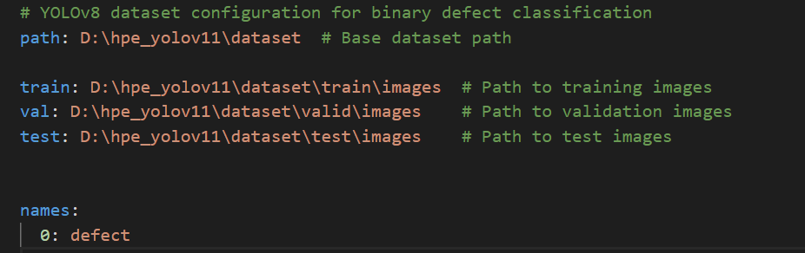
Yolov8
dataset.yaml:

Slide 3
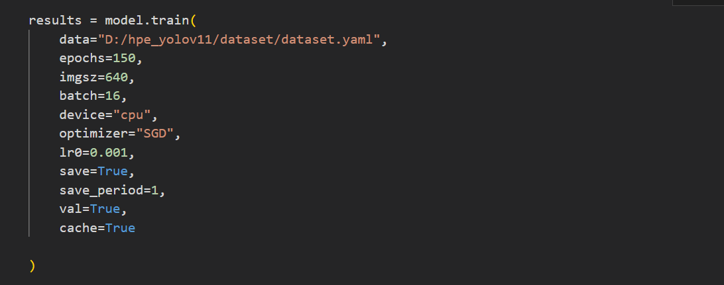
Yolov8 - First attempt of training
Training parameters:

Slide 4
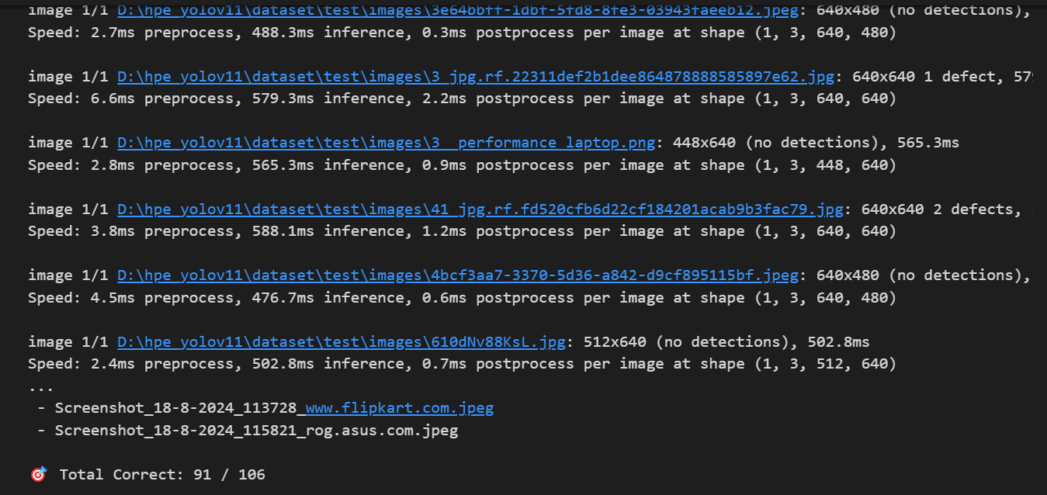
Yolov8 - Test results

Slide 5
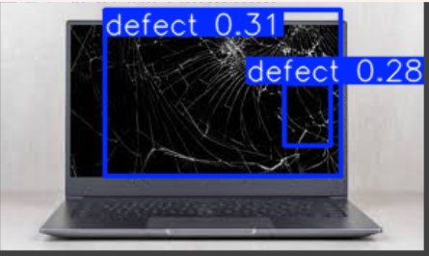
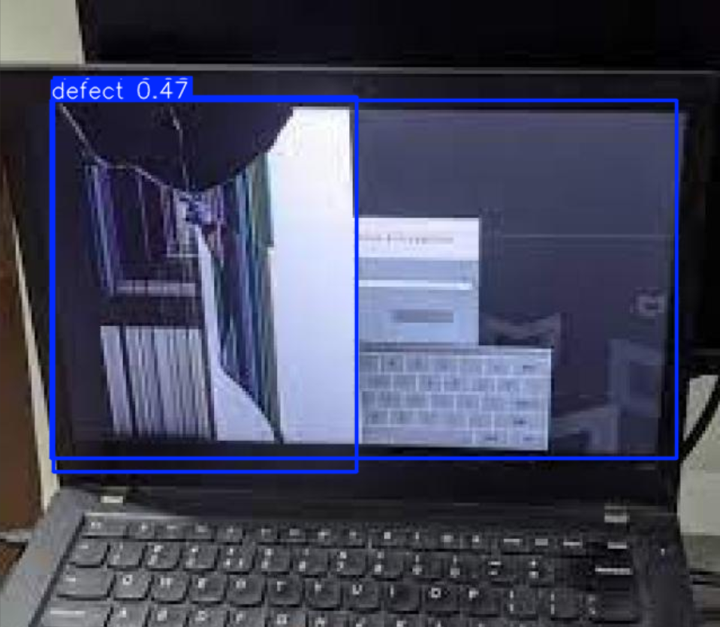
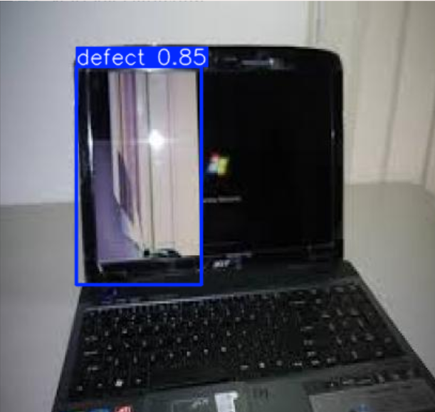
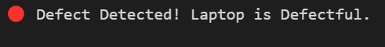
Yolov8 - Sample testing of defect images

Slide 6
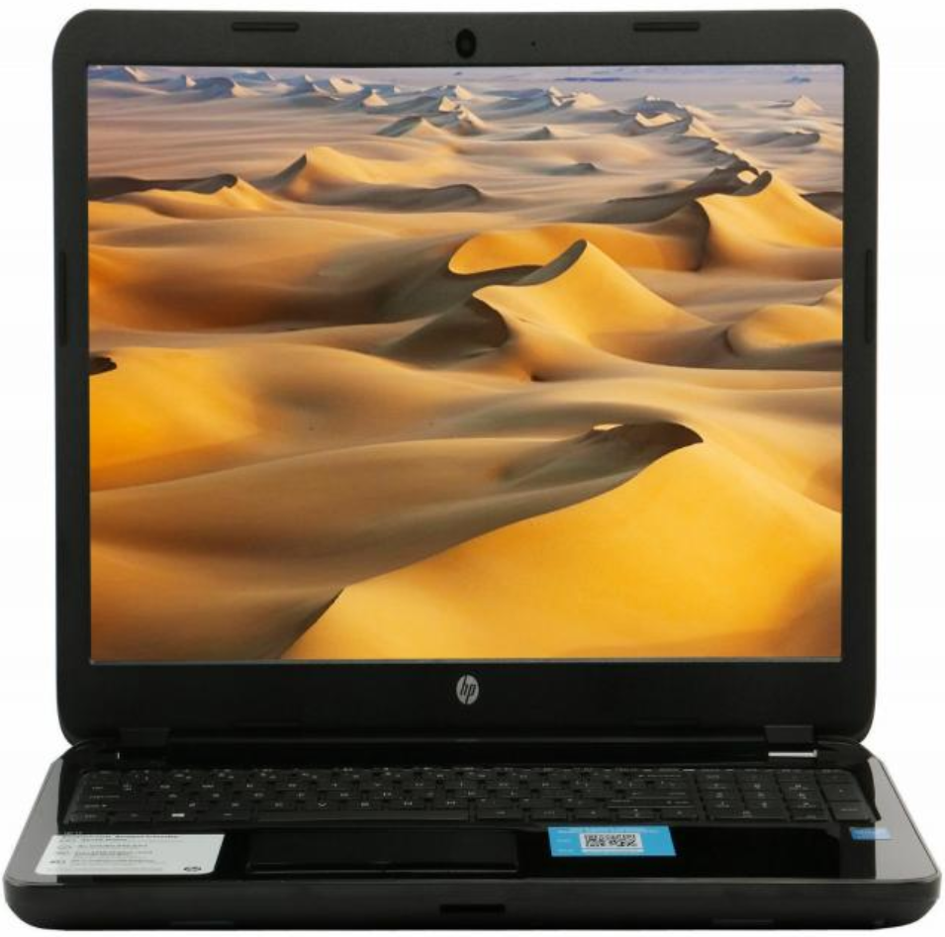
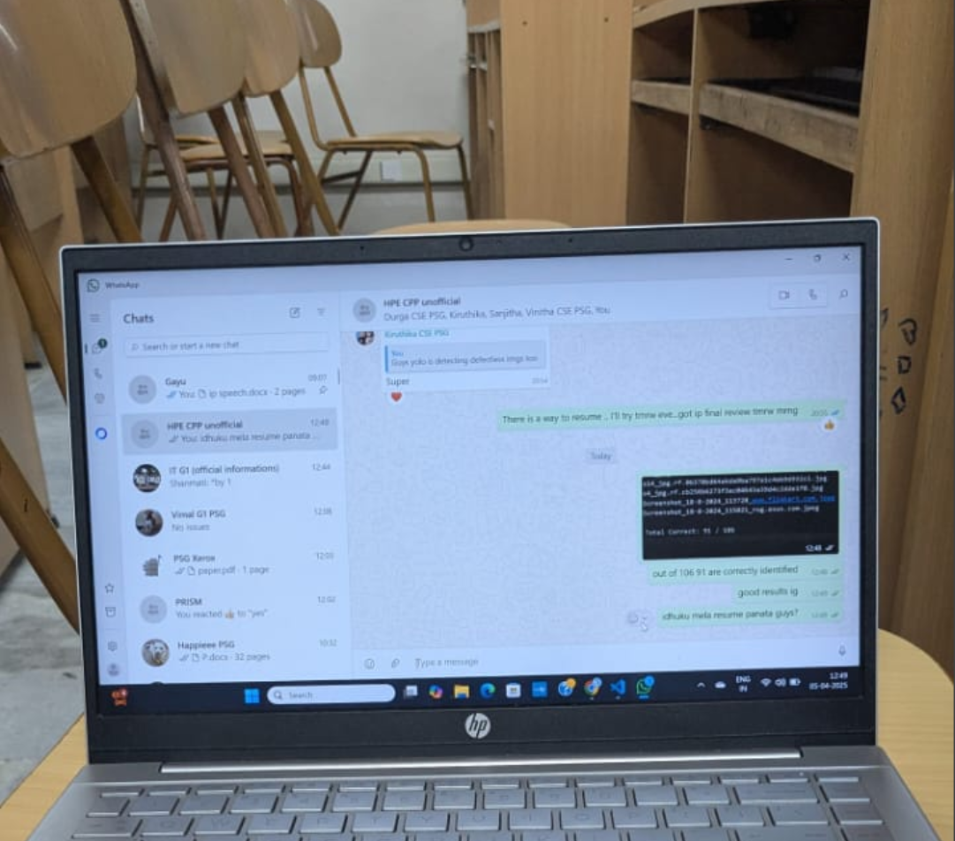
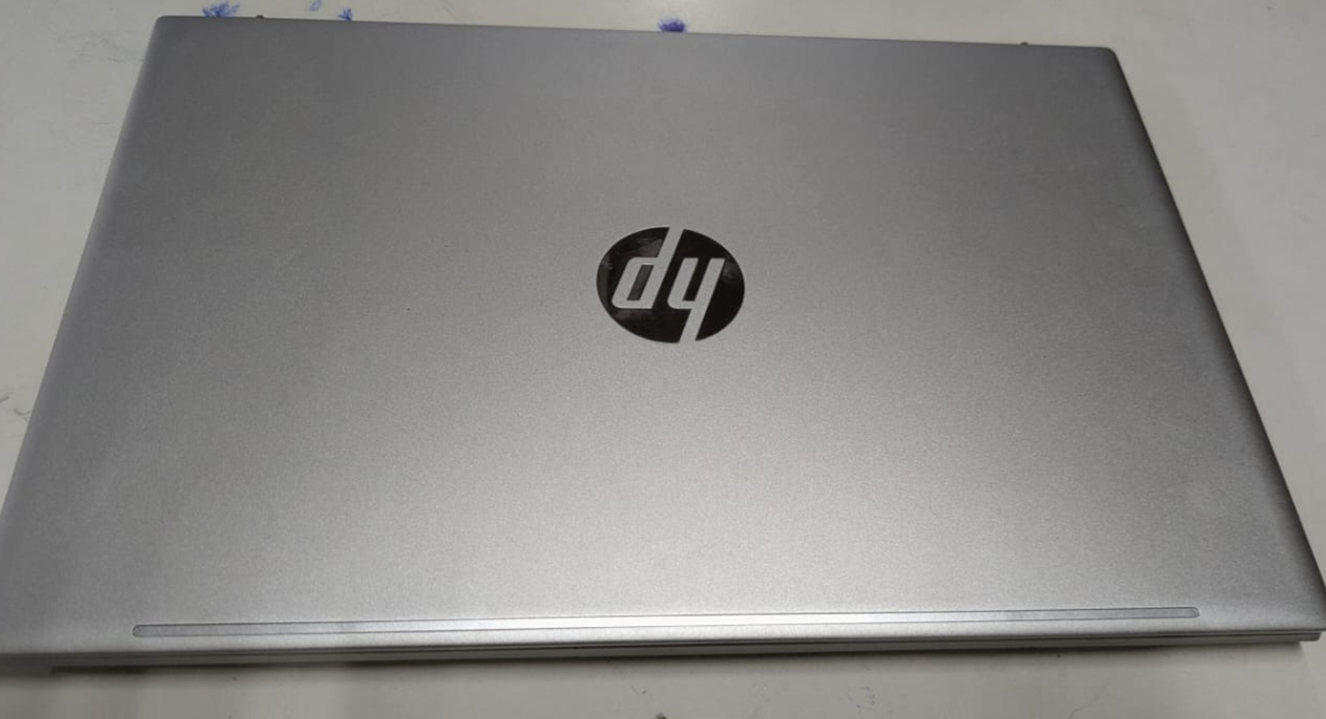
Yolov8 - Sample testing of defectless images

